Slide 1
Making Gestural Input More Practical
Louis Kratz^{1,2}, T. Scott Saponas¹, Dan Morris¹
¹Microsoft Research, Redmond, WA ²Drexel University, Philadelphia, PA
Notes:
[swat right]

Slide 2

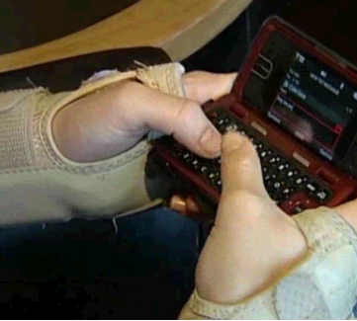
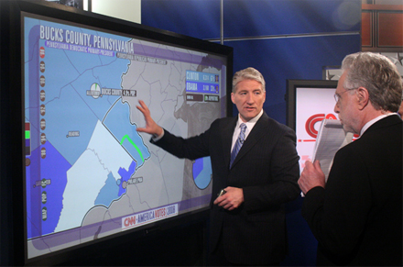
How Have You Interacted Today?
Notes:
Like you to think about…
Keyboard
Perhaps mobile phone
[point back]
Lucky: touchscreen
[point back]
Good for when you can use your hands or fingers for physical interaction with the device.
We’re interested in interaction when physically touching the device is inconvenient or impossible.
[swat right]

Slide 3
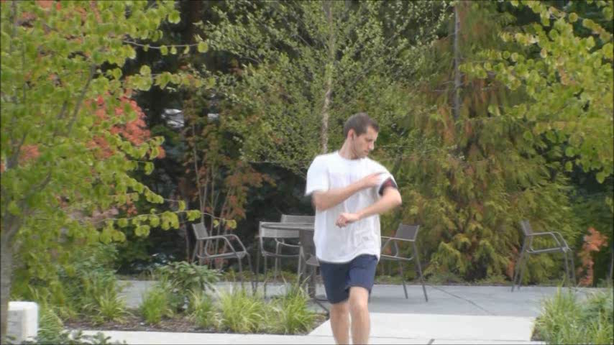
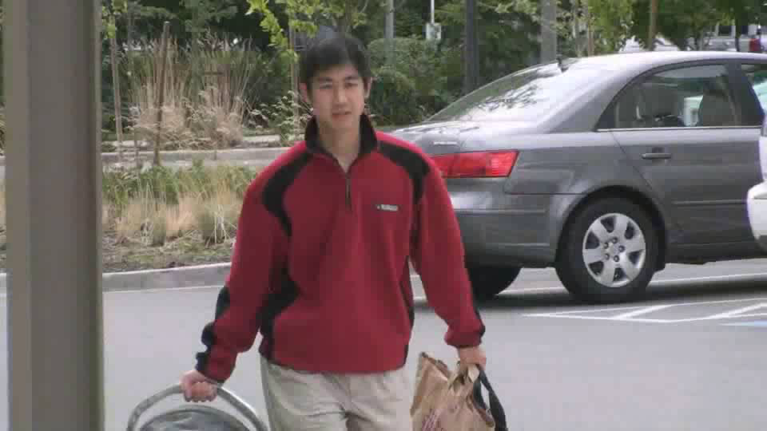
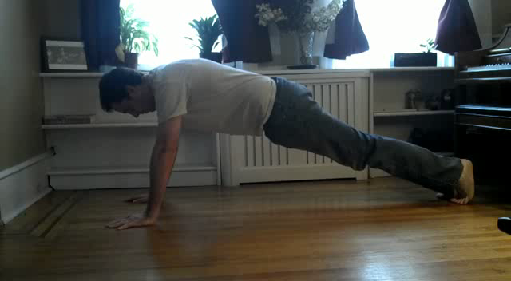
Notes:
For example:
Here this guy is running. Very inconvenient / impractical to interact w/ touchscreen.
[point back]
Another example – Hands may be occupied. Impractical. Exploring idea further: some times gesture recognition isn't about direct input to the device. Recognizing actions themselves are a form of sensing.
[point back]
Detecting when a user does a pushup, for example, is a form of gesture recognition.
None of these scenarios fit well with traditional input devices.
[swat right]

Slide 4
Our Goal
Make gesture recognition practical.
Reduce computational complexity
Improve recognition on new users
Notes:
Our goal is to make gesture recognition practical in these scenarios.
[point back]
Towards this goal, our note has 2 contributions.
Will dicuss the 2nd goal in this talk while demonstrating the first.
First, let’s get some terminology out of the way.
[swat right]

Slide 5
Recognition
Classification
Detection
Signal:
Which gesture?
When did a gesture occur?
Notes:
Consider two problems:
Classification: given signal
[wave down]
Answer question which gesture was it?
- know a gesture occurred.
[wave down]
More difficult problem is that of detection.
When a gesture occurs.
More difficult: less literature.
Both have a problem with new users.
[swat right]

Slide 6
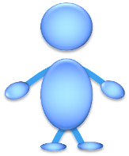

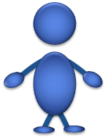
User Training Gap
User Specific
Generic Models
Accuracy:
~100%
~90%
Notes:
Significant work in recognition.
Conventional methods: high accuracy.
Do so at the cost of training on each user. Refer to as user-specific models.
Great for lab studies. But not practical
doesn't work in real world: too much required of user.
[point back]
Often, classifiers can be trained on a number of people, and used to classify a new user.
Refer to as Generic models.
Accuracy typically drops to about 90%
This is significant drop!
[swap right]

Slide 7
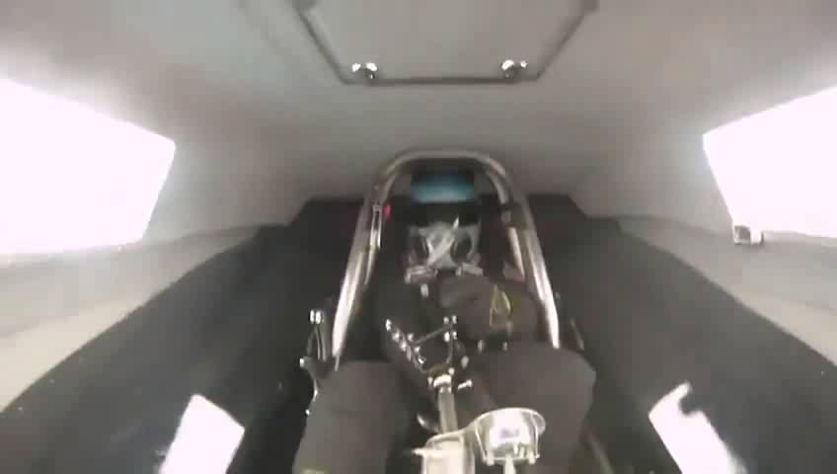

Slide 8
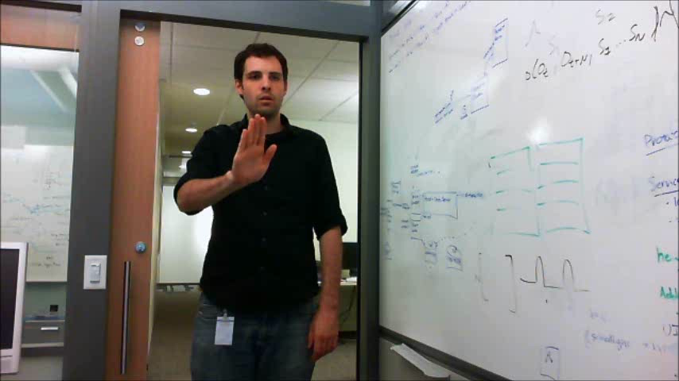
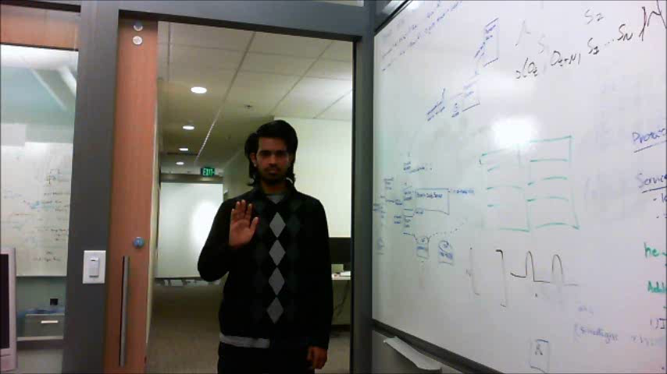
User Variation
Same gesture, different shape and signals!
Notes:
Let’s look a bit closer.
Say I make a circle
[Circle]
And another user makes the same gesture
[circle]
Same Gesture, difference shape!
Each user has unique signal:
personal style
physical differences
[Swat Right]

Slide 9
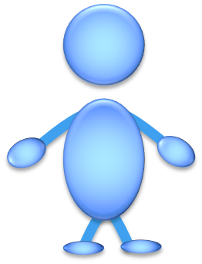
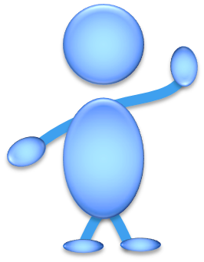

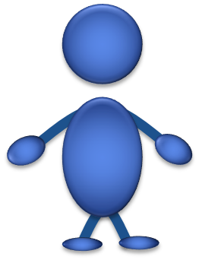
Mapping New Users
Training Database
New User
Buddy
Single
Example
Training Example
Notes:
We address by mapping new users to a “buddy user” already in the training set.
In other words, given a new user.
[point back]
We seek to identify a similar user in the training set.
Call the similar user a “buddy”
Then we get a SINGLE example gesture from the new user, and compare it to the training examples of the buddy.
Let’s look closer
[swat right]

Slide 10
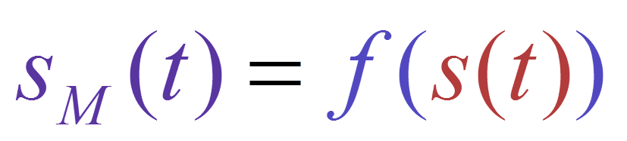
Mapping to Buddy Space
Training Example
Buddy’s Example
Linear mapping to buddy space
Notes:
We observe that the primary difference is in amplitude.
Natural: two users perform same gesture, but have different heights, will be scaled in sensing domain.
What we want to do is take the training example
[stretch out]
And stretch it out to match the buddy’s example.
We do this by estimating a linear transformation f from the training example s(t) to the buddy’s example sm
[Swat Right]

Slide 11
Classification Accuracy
Notes:
Evaluated with user-study
Users asked to wear accelerometer/gyro similar to the one here -> that I’m using to control this talk
8 users, 8 gestures
Explain graph.
Key point: Closed that 10% gap in accuracy!
[swat right]

Slide 12
Detection Accuracy
Notes:
Detection: MUCH more difficult.
User-specific: Likely the best we can do, around 95%
Generic detection: near 40% accuracy: terrible!
With buddy matching: up to 85% on average. Increase of 45% accuracy!
[swat right]

Slide 13
Conclusion
Find a buddy!
Notes:
Find a buddy so you too can give a talk using gesture recognition

Slide 14
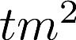
Detection Complexity
time
Length
1
2
m
t
Conventional:

Slide 15
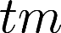
Detection Complexity
time
t
[Deng and Tsui, 2000]:
Notes:
2 problems:
Checks EVERY length (even 1)
Takes m time for each check

Slide 16
Detection Complexity
time
t
Ours:
Notes:
2 problems:
Checks EVERY length (even 1)
Takes m time for each check

Slide 17
Quantitative Comparison
Notes:
Trained on each users.

